Slide 1
MBJ Coffee Research
MBJ Coffee shop, is a relatively small company which can’t compete with big players in the current market. The company’s strategy is to build a vast network of shops in smaller cities. MBJ Coffee shop already has a strong presence in 140 locations and recently opened stores in 10 new cities. Additionally, the company has two separate sales regions.
The company wants to:
1) Identify which of the two sales regions is performing better (outperforming the other in 2 of the following 3 metrics).
Average Revenue per City.
Average Marketing spend per city(tip- less is better).
Average ROMI (Return on Marketing Investment) per city. Calculated as (revenue/marketing spend).
2). Identify which of the 10 new locations have the best potential for the company to invest more funds into marketing.

Slide 2
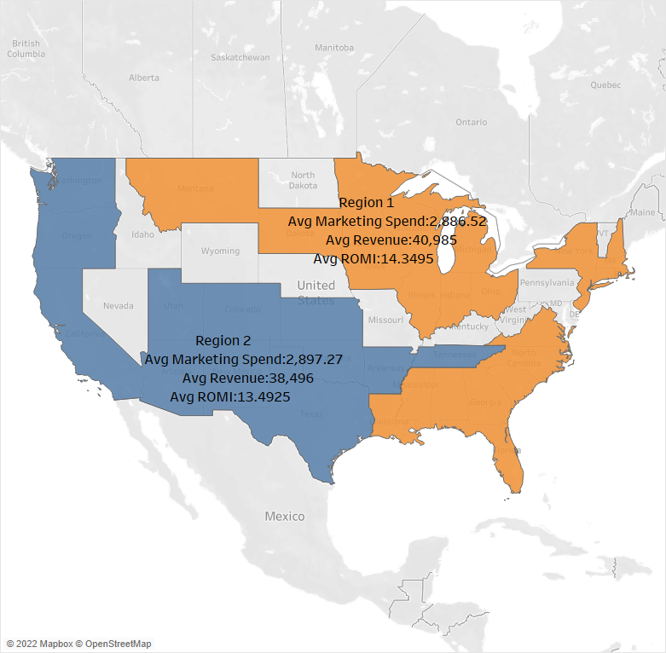
Regional Revenue

Slide 3
Results
Region 1 is performing better best on the three KPI criteria.
Average marketing spend was $ 2,886.52.
Average revenue return on our investment was $40,985.
Average ROMI $ 14.35.
Region 2 underperformed region 1.
Average marketing spend was $ 2,897.27.
Average revenue return on our investment was $38,496 .
Average ROMI $13.49
Conclusion:
Region 1 is doing better than region 2 based on KPI criteria given above. We spend more on marketing in region 2, but revenue return was less than region 1, where we spend less on marketing.

Slide 4
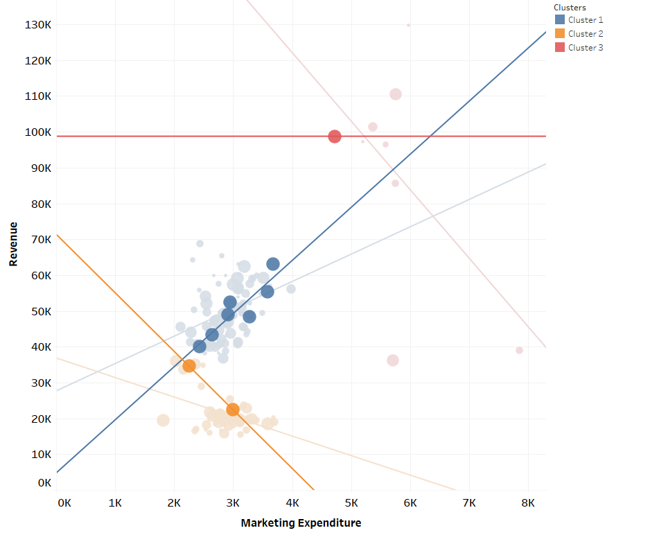
New Locations Analysis

Slide 5
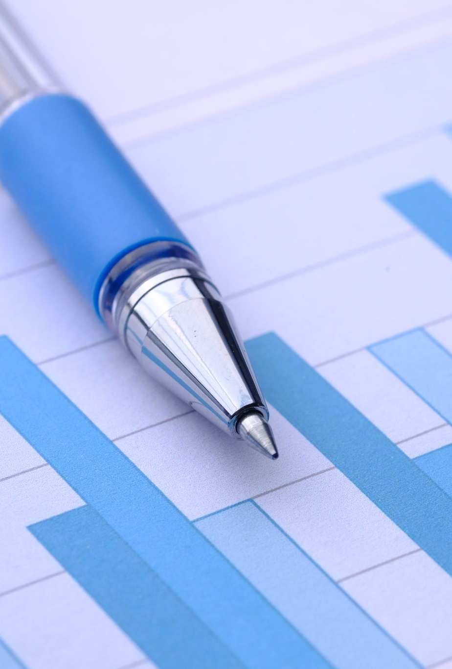
Clustering Analysis results
Cluster 1 : Has 7 new locations
Return on marketing expenditure is $7.63 for each $1 spend.
P-value: | 0.0006068
Equation: | Revenue = 7.63422*Marketing Spend + 27656.1

Slide 6
Clustering Analysis results
Cluster 2 : Has 2 new locations.
Return on marketing expenditure is $-5.45 for each $1 spend.
P-value: | 0.001648
Equation: | Revenue = -5.44822*Marketing Spend + 36845.7

Slide 7
Clustering Analysis results
Cluster 3: Has 1 new location
Return on marketing expenditure is $-19.13 for each $1 spend.
P-value: | 0.142716
Equation: | Revenue = -19.1349*Marketing Spend + 198653

Slide 8
Where to add more marketing expenditure?
7 new locations in cluster 1 or blue in color have the best potential to get more revenue for every dollar we spend on marketing. Return on every $1 dollar spend on marketing we get $7.63 in revenue, compared with the other two clusters where return on investment is $-5.45 in cluster 2 and $-19.13 in cluster 3 respectively.

Slide 9
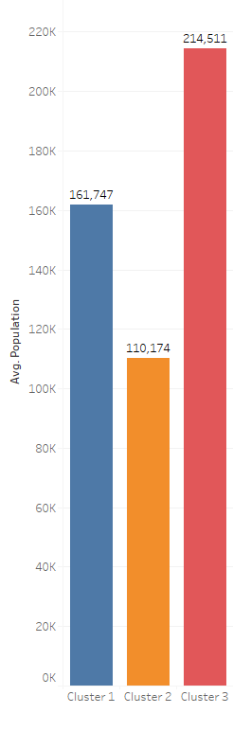
Population

Slide 10
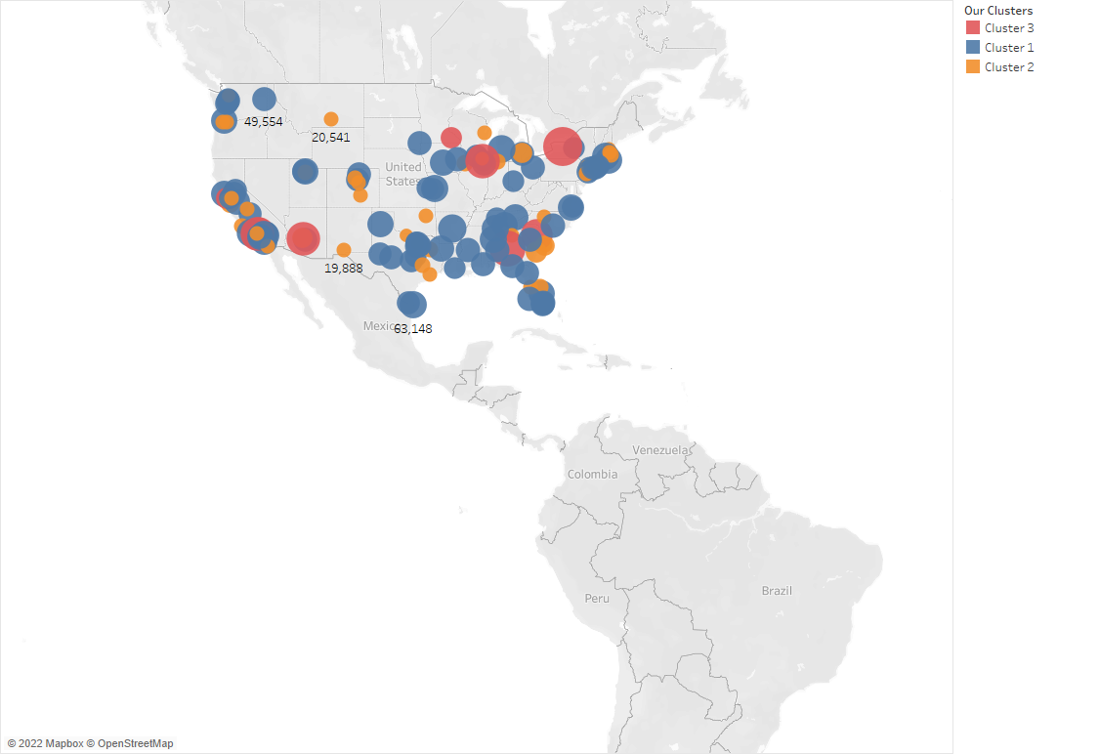
Revenue By City

Slide 11
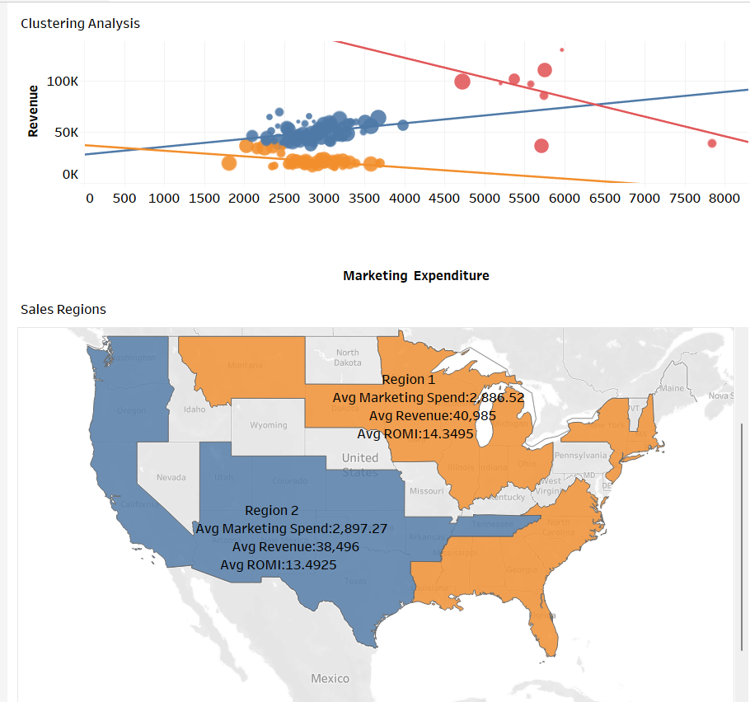
MBJ Dashboard

Slide 12
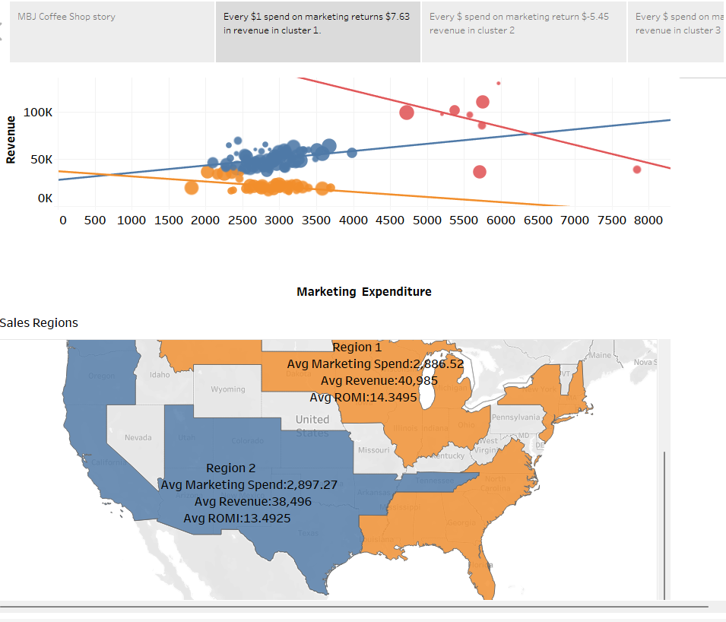
MBJ Storyline

